Slide 1
A One Stop Solution focusing on Tourism
PIP104 University Project-II
Final Review
Batch Number: ISE-03
Sl no. | Roll no. | Name | Dept./sem./year
1 | 20211ISE0036 | Tarun V | 7ISE-01/4th year
2 | 20211ISE0050 | Jithendra Gowda J | 7ISE-01/4th year
3 | 20211ISE0030 | Kaustubh P S | 7ISE-01/4th year
4 | 20191ISE0109 | Mujahid Ur Rehman | 7ISE-01/4th year
5 | 20201ISE9002 | Anusha P | 7ISE-01/4th year
Under the Supervision of,
Dr R Vignesh
Asso. Professor(SG)
School of Computer Science and Engineering
Presidency University

Slide 2
Problem Statement Number: PSCS200
Organization: Yamaha Motors Solutions
Category (Hardware / Software / Both) : Software
Project Description: A One Stop Solution Focusing Tourism simplifies travel planning by integrating hotel booking, trip planning, budget management, and bill splitting into a unified platform.
Difficulty Level: Simple

Slide 3
INTRODUCTION
A One Stop Solution Focusing Tourism integrates travel planning tools like booking, itineraries, budgeting, and cost-sharing into one platform.
Built using React, PHP, and MySQL, the platform ensures dynamic responsiveness, efficient backend operations, and secure data management.
Designed for accessibility, it supports non-tech-savvy users and offers scalability for future enhancements like AI-based recommendations and multilingual support.
Challenges like responsive design, database optimization, and secure data handling were addressed through rigorous testing and cybersecurity best practices.
The platform enhances user experience by streamlining travel planning, reducing inefficiencies, and encouraging adoption of digital tools for travel needs.

Slide 4
Literature Review
Technological Advancements in Travel:
Studies emphasize the role of technology, particularly mobile applications and algorithms, in enhancing travel experiences. For example, Zong (2024) proposed a recommendation system combining cloud and edge computing for instant, behavior-based answers.
User-Generated Content and Co-Creation:
Research by Graziano and Albanese (2020) highlights that tourists co-create digital content, but excessive user-generated value can lead to storage issues and false positives, raising concerns about data accuracy.
Digital Transformation and Accessibility:
Zhang and Szab (2024) explored digital transformation in Chinese tourism, while Teixeira et al. (2022) developed a mobile app prototype addressing accessibility challenges related to configuration and registration.
Engagement and Design in Tourism Apps:
Mazeda and Teixeira applied AR technology to cultural tourism, boosting engagement but leaving behavioral insights unaddressed. Martinez and Lopez (2023) emphasized that balancing simplicity and functionality in app design is critical for user satisfaction.
Social Media and Travel Decisions:
Dwityas and Briandana (2017) investigated how social media influences travel decisions by providing instant, reliable suggestions, showcasing its potential as a powerful tool in travel planning.

Slide 5
Proposed Method
Technology Stack Components:
HTML/CSS
JAVASCRIPT
OPENAI API
NODE JS
PHP
MYSQL

Slide 6
Proposed Method
Application Components:
Trip adviser
Trip Planner
Hotel Booking

Slide 7
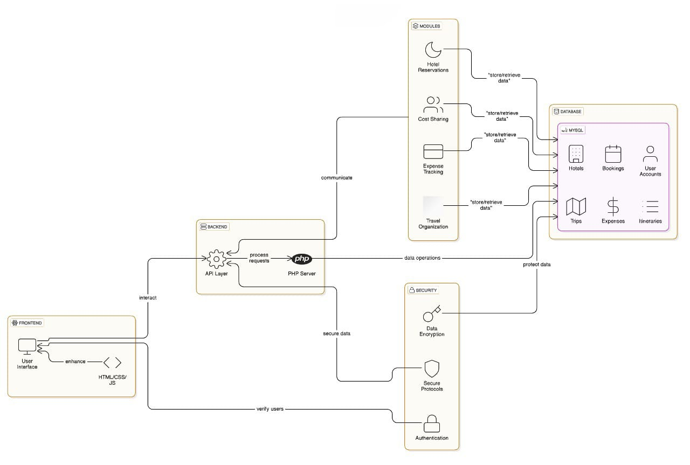
Proposed Method

Slide 8
Objectives
Smooth Travel Arrangements: Integration of hotel booking, itinerary generation, and expense tracking into one platform saves users' time and effort.
Improved Financial Oversight: Real-time budgeting tools enable users to plan trips within budget, efficiently tracking expenditures for stress-free travel.
Optimized Team Collaboration: Group-friendly features like bill-splitting and shared itineraries ensure transparency, enhancing the travel experience for groups.
Tailor-made User Experience: Personalized recommendations based on preferences, history, and budget deliver a more relevant and enjoyable travel experience.
International Accessibility: Designed for diverse technical skills and multilingual support, ensuring inclusivity and global accessibility across devices.

Slide 9
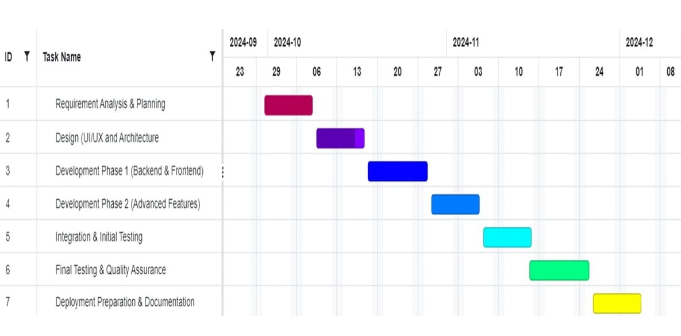
Timeline of Project

Slide 10
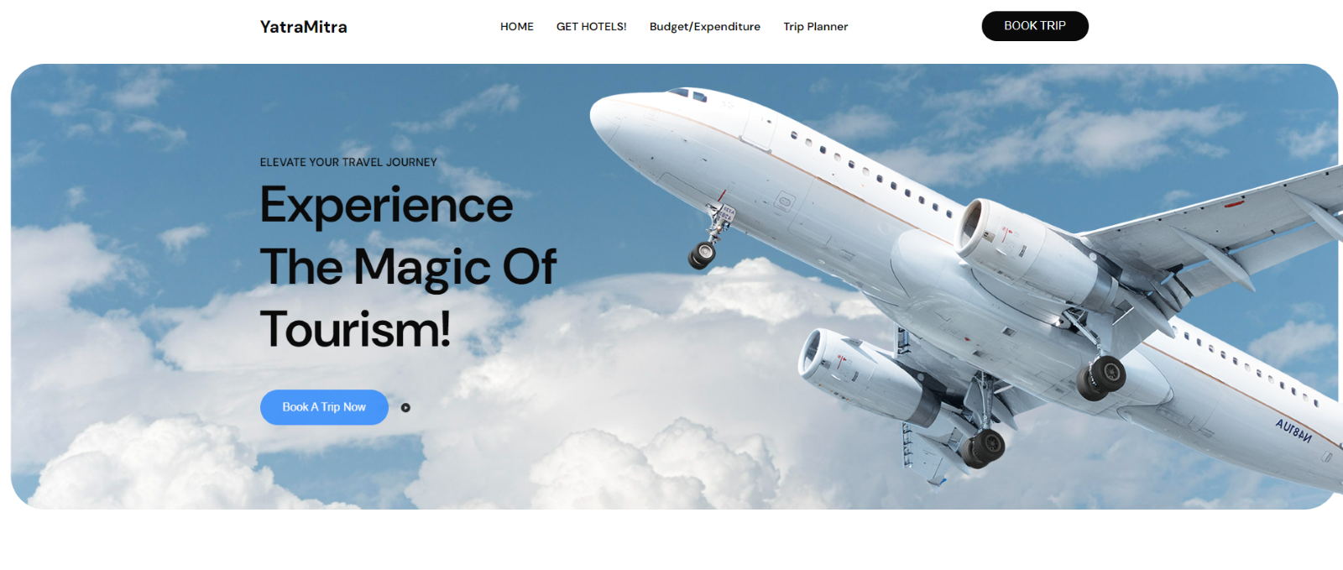
Outcomes

Slide 11
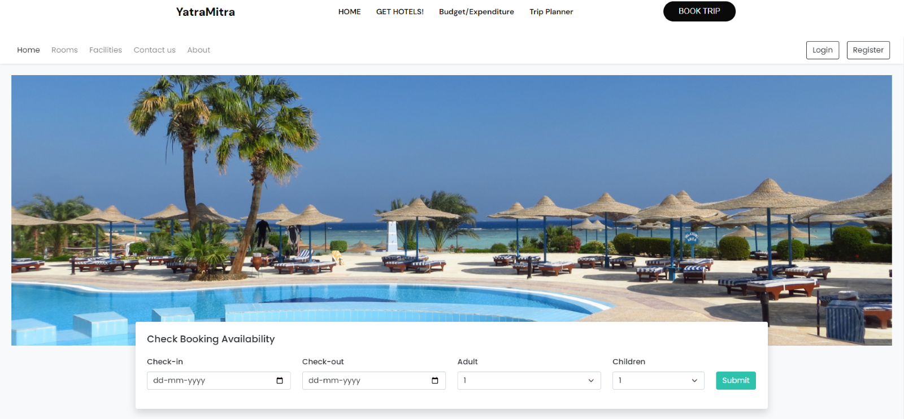
Outcomes

Slide 12
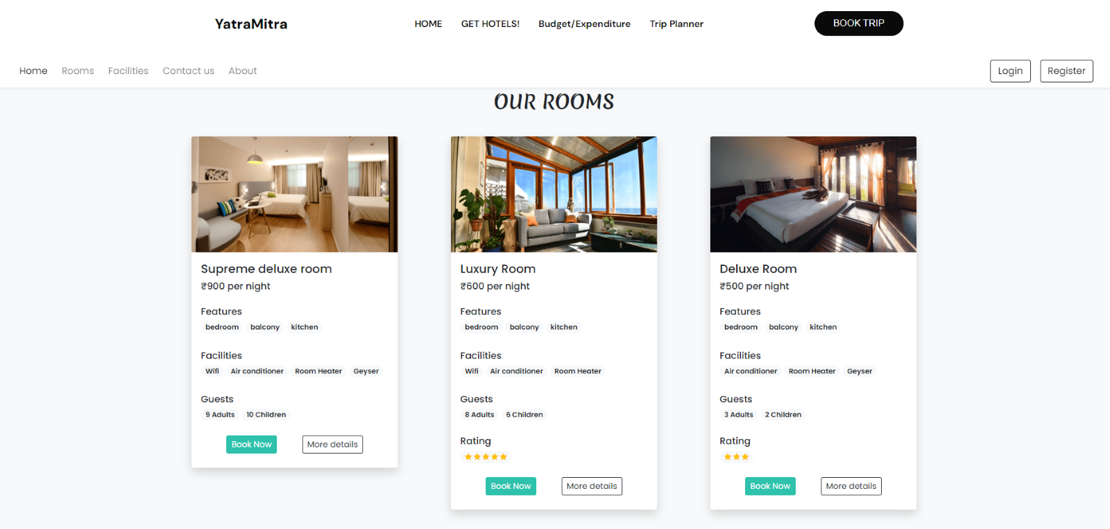
Outcomes

Slide 13
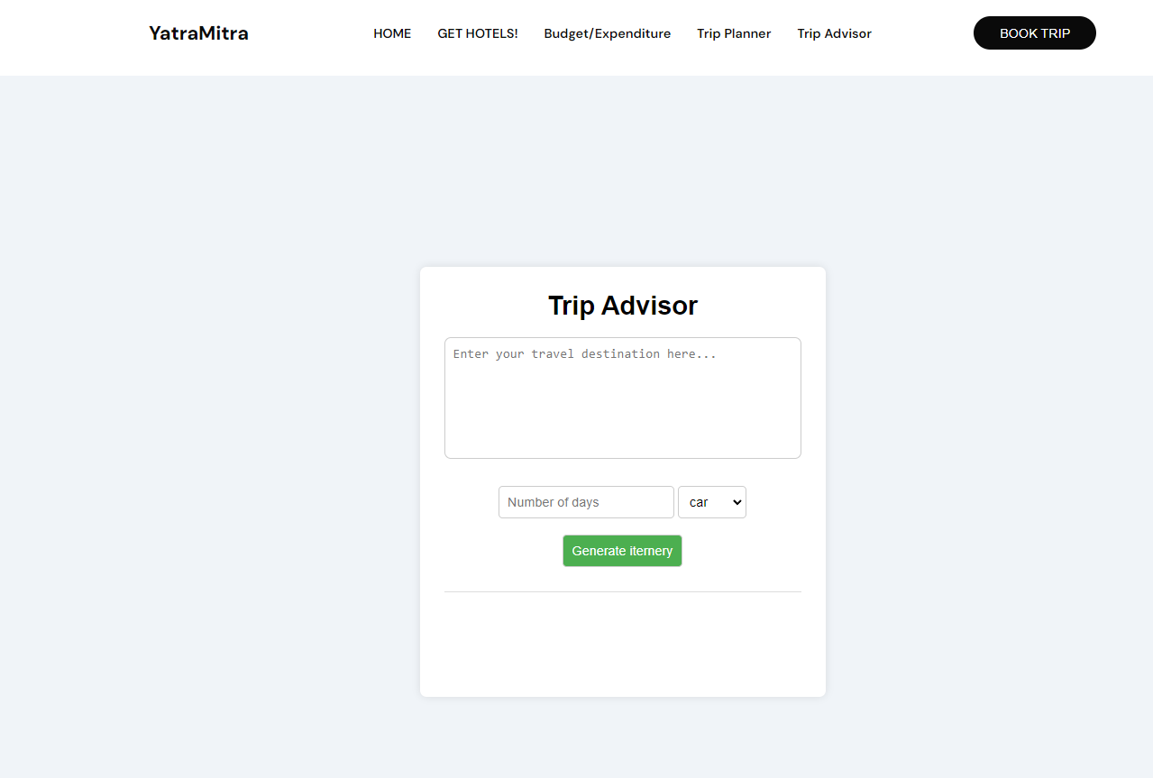
Outcomes

Slide 14
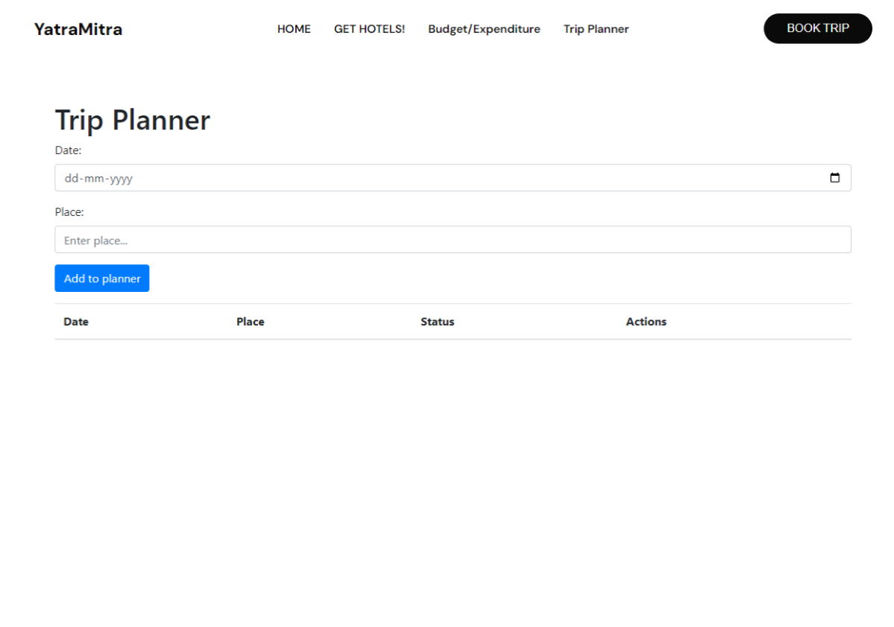
Outcomes

Slide 15
Conclusion
A One Stop Solution Focusing Tourism simplifies travel planning by integrating hotel booking, trip planning, budget management, and bill splitting into a unified platform. Built with React, PHP, and MySQL, it ensures responsiveness, security, and scalability. Overcoming challenges like database optimization and UI design, it offers a seamless, user-friendly experience, redefining digital travel solutions and enhancing group collaboration.

Slide 16
References
A Personalized Recommendation Algorithm for Tourist Attractions Using User Behavior Data -Rong Zong (2024)
Smart Tourism: Foundations and Developments-Gretzel et al. (2015)
Online Place Branding for Natural Heritage: Institutional Strategies and Users’ Perceptions of Mount Etna -Teresa Graziano, Valentina Erminia Albanese (2020)
Digital Transformation in the Tourism Industry: A Comparative Literature Review -Yuan Zhang, Zoltan Szab (2024)
Evaluation of an Integrated Intermodal Travel Service-Beutel, Zaunbrecher, Himmel, Krempels, Ziefle (2022)

Slide 17
Thank You

